Slide 1
Software Project Management

Slide 2

Software Project Acquisition

Slide 3
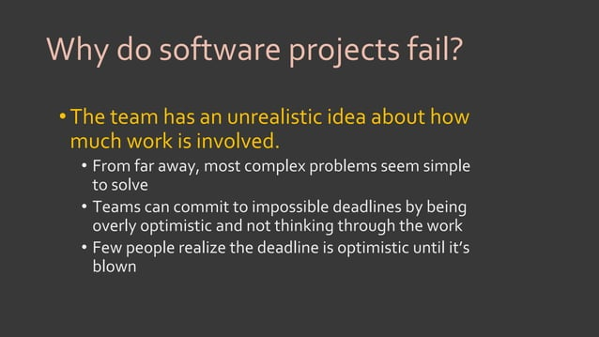

Slide 4
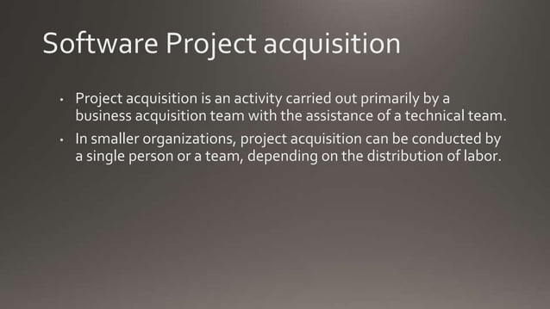

Slide 5
Project acquisition
Process of obtaining or acquiring a project for your organization. It is the process of identifying, evaluating, and acquiring software projects that align with an organization's strategic goals. It involves identifying potential projects, evaluating their feasibility, and taking the necessary steps to secure the project for execution.
Project Identification, Feasibility Analysis, Proposal Development including project's details, objectives, scope, estimated costs, benefits, and risks often used to seek approval and funding from senior management or external stakeholders, Project Selection, Contract Negotiation, Funding and Resourcing, Project Kickoff (official initiation)

Slide 6
Software Project Acquisition
It is a complex process that involves a variety of steps, including:
Identifying potential projects. This can be done through a variety of methods, such as networking with other organizations, attending industry events, and searching for online listings.
Evaluating potential projects. Once a list of potential projects has been identified, it is important to evaluate them carefully to determine which ones are the best fit for the organization. This evaluation should take into account factors such as the project's strategic alignment, profitability potential, technical complexity, and risk profile.

Slide 7
Negotiating and acquiring projects. Once a project has been selected, the organization will need to negotiate and acquire it. This may involve developing a purchase agreement, and obtaining financing.
Integrating the acquired project. Once the project has been acquired, it is important to integrate it into the organization's existing operations. This may involve restructuring the organization, transferring knowledge and skills, and aligning the project's culture with the organization's culture.

Slide 8
Importance
Software project acquisition can be a valuable strategy for organizations that are looking to grow quickly, expand their capabilities, and increase their profits.
However, it is important to carefully evaluate projects before acquiring them and to have a plan for integrating them into the organization's existing operations.

Slide 9
Benefits
Here are some of the key benefits of software project acquisition:
Accelerated growth. Software project acquisition can help organizations to grow more quickly than they could through internal development alone.
Expanded capabilities. Software project acquisition can help organizations to expand their capabilities and enter new markets.
Increased profitability. Software project acquisition can help organizations to increase their profits by acquiring projects that are already profitable or that have the potential to become profitable.
Access to new talent and expertise. Software project acquisition can give organizations access to new talent and expertise that they may not have in-house.

Slide 10
Acquisition risks
However, there are also some risks associated with software project acquisition, such as:
Overpaying for projects. It is important to carefully evaluate projects before acquiring them to ensure that the organization is not overpaying.
Integration challenges. Integrating an acquired software project into the organization's existing operations can be challenging.
Cultural clashes. There may be cultural clashes between the acquired software project team and the organization's existing team.

Slide 11
Example
A financial services company is looking to develop a new mobile app for its customers. The company identifies a mobile app development company that has a successful track record of developing mobile apps for financial services companies. The company evaluates the mobile app development company and determines that it is profitable, has a team of experienced developers, and has a good understanding of the financial services industry. The company then negotiates and acquires the mobile app development company. After the acquisition, the company integrates the mobile app development company into its existing operations. The company now has the ability to develop mobile apps, which allows it to enter a new market and expand its capabilities.
Overall, software project acquisition can be a complex but rewarding process for organizations that are looking to grow quickly, expand their capabilities, and increase their profits.

Slide 12
Acquiring a software project from an external client
Acquiring a software project from an external client involves a series of steps and considerations to ensure a successful collaboration.

Slide 13
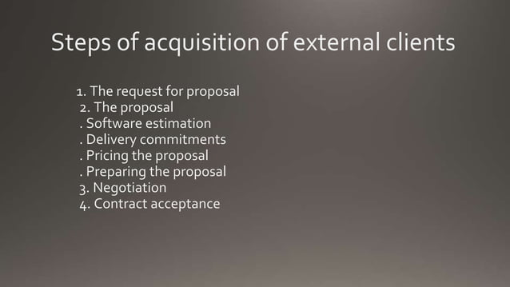

Slide 14
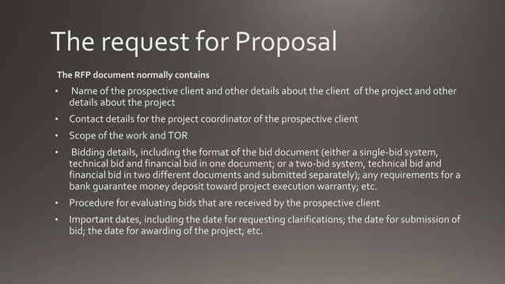

Slide 15


Slide 16
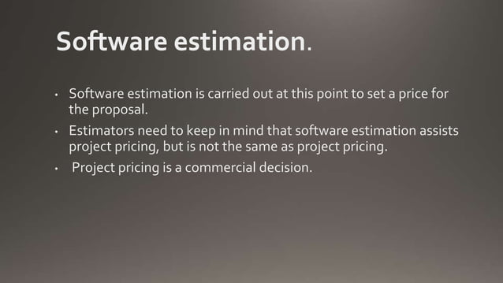

Slide 17
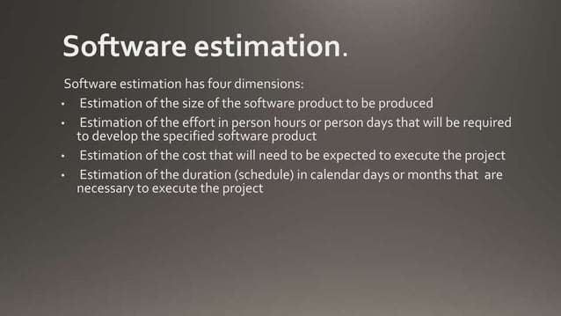

Slide 18
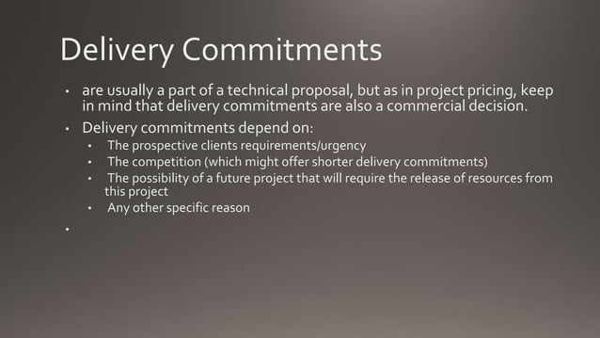

Slide 19
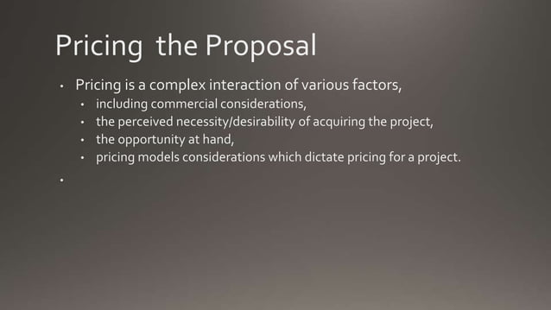

Slide 20
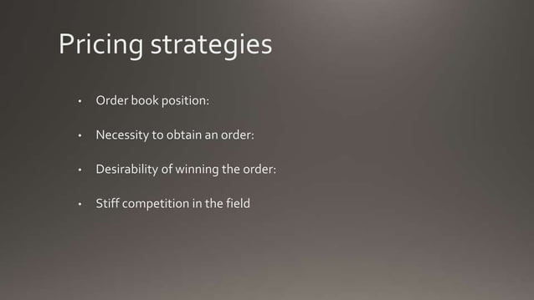

Slide 21
Project Acquisition from internal clients
It refers to the process of identifying, securing, and managing projects or work assignments within an organization, where the clients or project sponsors are individuals or teams from within the same organization.
This approach is common in larger organizations where different departments or teams may request or initiate projects to meet specific goals, solve problems, or improve internal processes. Here are key aspects of project acquisition from internal clients:
Client Identification: Internal clients can be various departments, teams, or individuals within the organization. These clients may include marketing, research and development, operations, human resources, or any other functional area within the company.

Slide 22
Project Acquisition from internal clients
Client Needs Assessment: To acquire projects from internal clients, it's essential to engage in a comprehensive needs assessment. This involves understanding the objectives, challenges, and requirements of the internal client.
Alignment with Organizational Goals: Projects from internal clients are expected to align with the broader strategic goals and mission of the organization. The projects should contribute to the success of the company as a whole.
Resource Allocation: Acquiring internal client projects often involves securing resources, both human and financial, to execute the project successfully. These resources may be shared or allocated specifically for the project.
Project Proposal: Internal clients typically present project proposals, outlining the project's scope, objectives, expected outcomes, and resource requirements. These proposals are evaluated for feasibility and alignment with organizational objectives.

Slide 23
Project Acquisition from internal clients
Budget and Cost Estimates: Project acquisition may also involve the estimation of project costs and the development of budgets. This is important for securing financial resources and tracking expenses.
Project Prioritization: Organizations may have limited resources, so project acquisition from internal clients often requires prioritization based on factors such as strategic importance, resource availability, and expected impact.
Project Management: Once a project is acquired, it is managed according to established project management methodologies, involving planning, execution, monitoring, and control.

Slide 24
Project Acquisition from internal clients
Communication and Collaboration: Effective communication and collaboration are crucial when acquiring projects from internal clients. Close coordination with the client, stakeholders, and relevant departments is essential for project success.
Evaluation and Feedback: After project completion, evaluation and feedback from the internal client are important for assessing project success and identifying areas for improvement.

Slide 25
Key Differentiation Aspects w.r.t. Internal Clients
Project Acquisition from Internal Clients:
Relationship: Internal clients are typically individuals or teams within the same organization. The relationship is built on familiarity and ongoing collaboration.
Alignment with Organizational Goals: Projects from internal clients are generally closely aligned with the organization's strategic objectives and mission. They are often aimed at improving processes, products, or services within the company.

Slide 26
Key Differentiation Aspects w.r.t. Internal Clients
Access to Resources: Internal clients have access to internal resources, such as existing data, infrastructure, and subject matter experts. This can streamline project execution.
Interdepartmental Coordination: Projects from internal clients may require coordination with various departments, making communication and collaboration crucial.

Slide 27
Key Differentiation Aspects w.r.t. Internal Clients
Priority: Priority is usually determined by the organization's overall strategic goals and resource availability. Projects from internal clients may need to compete for resources with other internal initiatives.
Knowledge and Culture: Understanding the organization's culture, internal processes, and politics is essential when acquiring projects from internal clients.

Slide 28
Key Differentiation Aspects w.r.t. External Clients
Relationship: External clients are individuals or organizations outside the company. The relationship is often transactional, with a focus on meeting specific client needs.
Contractual Agreements: Projects from external clients are typically governed by contractual agreements, which define the scope, terms, and expectations. These agreements can be legally binding.

Slide 29
Key Differentiation Aspects w.r.t. External Clients
Market Competition: Organizations may compete to win projects from external clients, often through competitive bidding, proposals, or sales efforts.
Client-Centric Approach: Projects from external clients require a client-centric approach, understanding the client's needs, preferences, and expectations.
Resource Availability: Organizations may need to allocate resources specifically for external client projects. These resources may not be shared with internal projects.

Slide 30
Key Differentiation Aspects w.r.t. External Clients
Project Control: External client projects may provide greater control over project management, as the organization has more flexibility to define the project's scope and objectives based on the client's requirements.
Profit and Revenue: Projects from external clients are typically driven by the potential for profit and revenue generation. Client satisfaction is crucial for building long-term relationships and securing future projects.

Slide 31
Summary
In summary, project acquisition from internal clients often involves addressing internal organizational needs and aligning with the company's broader strategic goals.
On the other hand, project acquisition from external clients is characterized by a client-centric approach, contractual agreements, and a focus on profit and revenue generation.
Both approaches require different strategies and considerations to be successful.

Slide 32
Remember that acquiring a software project from an external client requires effective communication, professionalism, and the ability to deliver high-quality solutions that meet or exceed client expectations.
Building trust and fostering a positive client relationship is essential for long-term success.

